Slide 1

Depression & Drug Use
Vanessa Okosun
Capstone Project – BDA 650
Mercer University Stetson School of Business

Slide 2
AGENDA
01
02
03
04
Statistics
Objective
Insights
NHNES Background
05
Results
06
07
Recomm-
endations
References
1

Slide 3

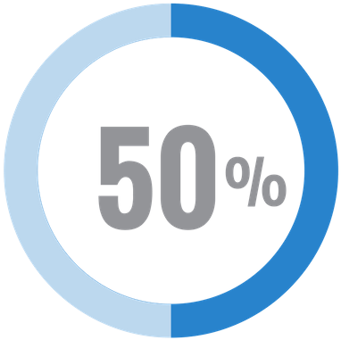

STATISTICS
The number of overdose deaths increases annually at 4.0%.
Depression is defined as a period of at least two weeks when a person experienced a depressed mood or loss of interest or pleasure in daily activities and had specified symptoms, such as problems with sleep, eating, energy, concentration, or self-worth.
Major depression is one of the most common mental disorders in the United States and about 18.5% of adults had symptoms of depression that were either mild, moderate, or severe in the past 2 weeks.
50% of people from the age of 12 have used illicit drugs at least once.
22% of males and 17% of females used illegal drugs or misused prescription drugs within the last year.
2

Slide 4
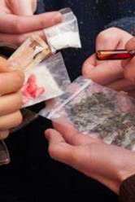
OBJECTIVE
Does being depressed and other external factors increase the chances of a person being a drug user?
3

Slide 5
National Health and Nutrition Examination Survey
2017-2018
program of studies designed to assess the health and nutritional status of adults and children in the United States
combines interviews and physical examinations
Findings from this survey will be used to determine the prevalence of major diseases and risk factors for diseases.
The survey examines a nationally representative sample of about 5,000 persons each year. These persons are located in counties across the country, 15 of which are visited each year.
4

Slide 6
Example of Questions asked in scales
DPINTEREST | Have little interest in doing things
DPFEEL | how often have you been bothered by the following problems: feeling down, depressed, or hopeless?
DPSLEEP | Trouble sleeping or sleeping too much
DPENERGY | Feeling tired or having little energy
DPAPPETITE | Poor appetite or overeating
DPSELF | Feeling bad about yourself
DPCONCEN | Trouble concentrating on things
DPSPEAK | Moving or speaking slowly or too fast
DPTHOUGHT | Thought you would be better off dead
DPDifficulty | Difficulty these problems have caused
DUQ211 | Used marijuana every month for a year?
DUQ215Q | Time since last used marijuana regularly
DUQ230 | # days used marijuana or hashish/month
DUQ250 | Ever use any form of cocaine
DUQ280 | # of days used cocaine/month
DUQ290 | Ever used heroin
DUQ320 | # of days used heroin/month
DUQ330 | Ever used methamphetamine
DUQ340 | Age first used methamphetamine
DUQ350Q | Last time used methamphetamine
DUQ360 | # days used methamphetamine/month
DUQ370 | Ever use a needle to inject illegal drug
DUQ410 | # times injected drugs/lifetime
DUQ430 | Ever been in rehabilitation program
5
Notes:
Patient Health Questionnaire (Depression)

Slide 7

Data Insights

Slide 8
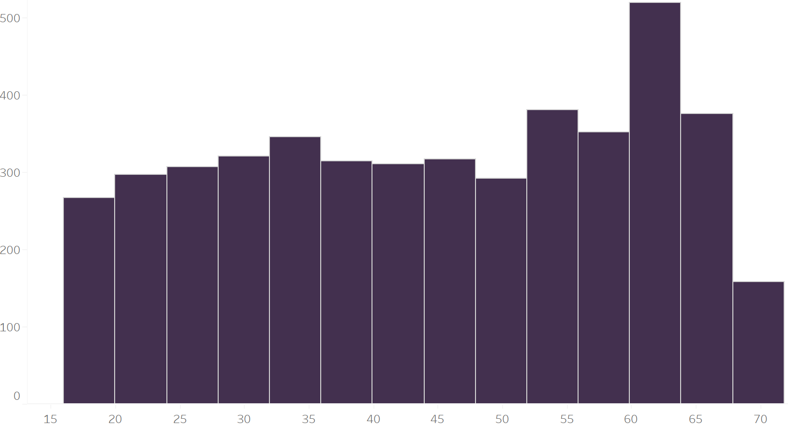
Data Insights
Race/Hispanic Origin
Gender
Age
6

Slide 9
48 variables and 4572 observations in this dataset.
10 variables were used for depression classification.
6 variables were used for drug user classification
7

Slide 10
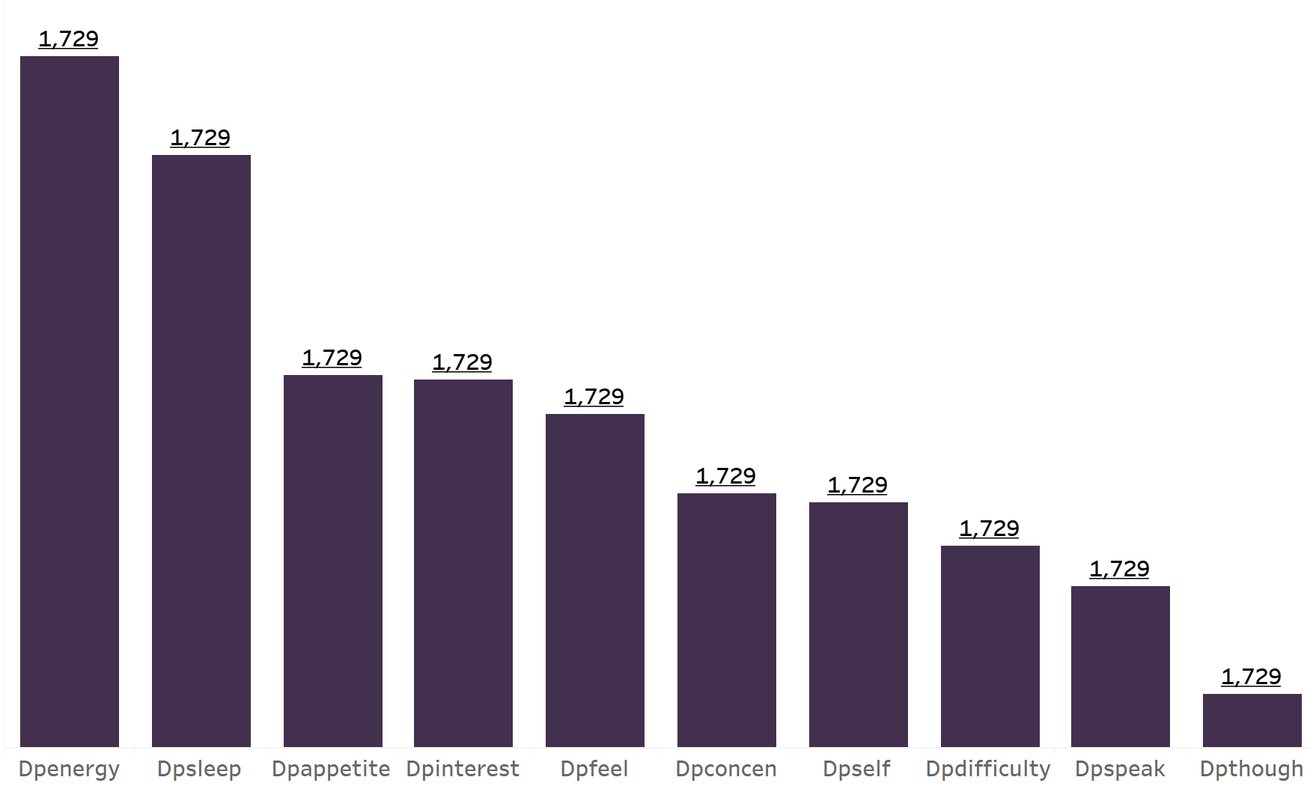
Depression Classification
Depression Scale
(categorized into 5 levels):
normal (score 0 – 4), minimal (score 5 – 9), mild (score 10 – 14), moderate (score 15 – 19), and moderately severe (score > 19).
8

Slide 11
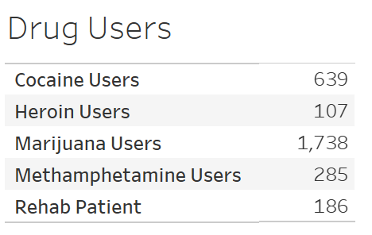
Drug User Classification
Drug Use was classified if they have tried the following drugs at least once. The more drugs they try the higher the drug index
Marijuana
Cocaine
Heroine
Methamphetamine
Illegal Injected Drugs
Also being Rehab Patient was considered
8

Slide 12
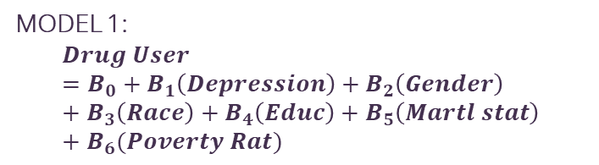
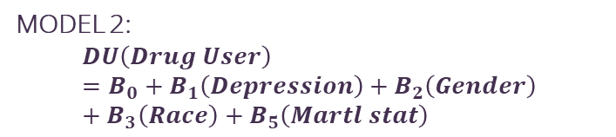
Logic Regression
MODEL 1:
$$Drug User=B_{0}+B_{1}\left(Depression\right)+B_{2}\left(Gender\right)+B_{3}\left(Race\right)+B_{4}\left(Educ\right)+B_{5}\left(Martl stat\right)+B_{6}(Poverty Rat)$$
MODEL 2:
$$DU\left(Drug User\right)=B_{0}+B_{1}\left(Depression\right)+B_{2}\left(Gender\right)+B_{3}\left(Race\right)+B_{5}\left(Martl stat\right)$$
Variable | P-value
Depressed | Significant
Gender | Significant
Race | Significant
EDUC | Not significant
MARTL | Significant
POVRAT | Not Significant
Variable | P-Value
Depressed | Significant
Gender | Significant
MARTL | Significant
Race | Significant
Those who are depressed are 49% more likely to be drug users
Females are 48% less likely to be drug users.
African Americans are 29% more likely to be drug users
Those who are married are 57% less likely to be drug users
9
Notes:
Binary logistic regression predicts the relationship between the independent and binary dependent variables.

Slide 13

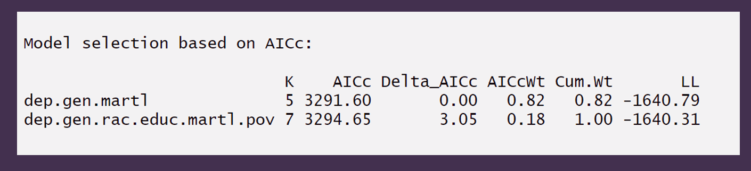
Model Comparison
Advertising
PR
AICc
Mercury is the closest planet to the Sun and the smallest one in the Solar System—it’s only a bit larger than our Moon
Venus has a beautiful name and is the second planet from the Sun. It’s terribly hot, even hotter than Mercury
AICcWt
The AIC value of the model. The model that explains the most variation in the data has a lower value
The proportion of the total predictive power that can be found in the model.
10

Slide 14
Variable Importance
Shows the importance of each predictor variable in the model.
The higher the score, the more important the variable is
11

Slide 15
Prediction
PERSON A
PERSON B
Gender | Female
Race | African American
Education | Highschool or below
Marital Status | Not Married
Poverty Ratio | 2.17
Depressed | Yes
Gender | Female
Race | African American
Education | Highschool or below
Marital Status | Not Married
Poverty Ratio | 2.17
Depressed | No
Being Female, African American, Up to high school education, not being married, a poverty ratio of 2.17, and Depressed status of “Yes” has a predicted probability of being a drug user of .3796.
Conversely, an individual with the same gender, race, marital status, educ, and poverty rate but with a depression status of “No” has a predicted probability of being a drug user of 0.2414.
12
Notes:
POV Ratio: 12.3 percent

Slide 16
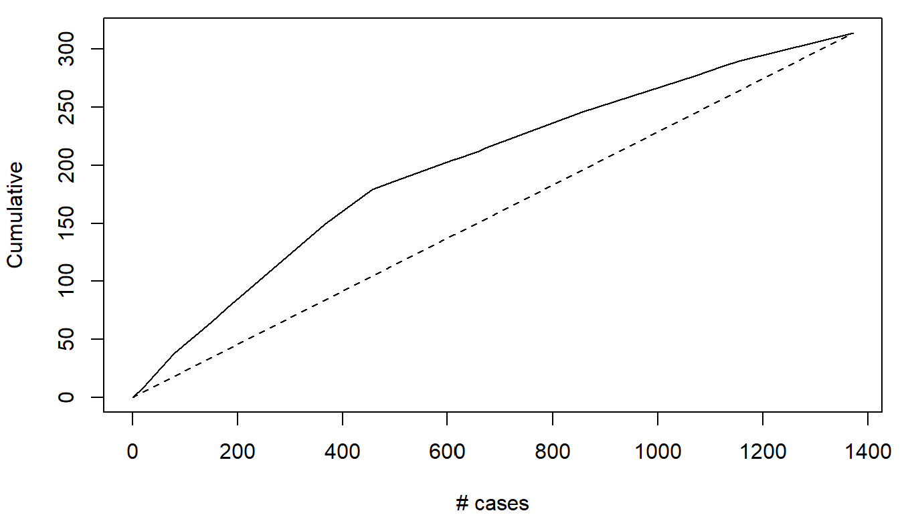
Lift Chart
The charts are based on the validation data of 1400 people.
The model’s predictive performance in terms of lift is better than the baseline model since its lift curve is higher than that of the baseline model.
13

Slide 17
Simultaneous Equations Model
DRUG USE
DEPRESSION
Depression
Marij_price – $7.38 price/g
Cocaine_price - $84 price/g
Heroin_price - $69 price/g
Meth_price - $40 price/g
Drug User
Marital Status
Gender
Income
Variable | Coeeficient | P- value
Depressed | 0.1498 | 0.0082
Marij_price | 0.0610 | 2.22E-16
Cocaine_price | 0.0043 | 2.22E-16
Heroin_price | 0.0034 | 9.99E-14
Meth_price | 0.0022 | 9.11E-05
Variable | Coeeficient | P- value
Drug_user | 0.215 | 2.22E-16
Gender | 0.076 | 2.17873E-10
MARTL | -0.056 | 7.9546E-06
Income | -0.121 | 2.22E-16
14
Notes:
POV Ratio: 12.3 percent

Slide 18



Recommendations
Mental health checkups should be a part of yearly physicals for prevention purposes.
Early intervention strategies can reduce the impact of substance use and mental disorders in America’s communities
More research to boost protective factors and eliminate or reduce risk factors for drug use
15

Slide 19

Questions?

Slide 20

APPENDIX

Slide 21
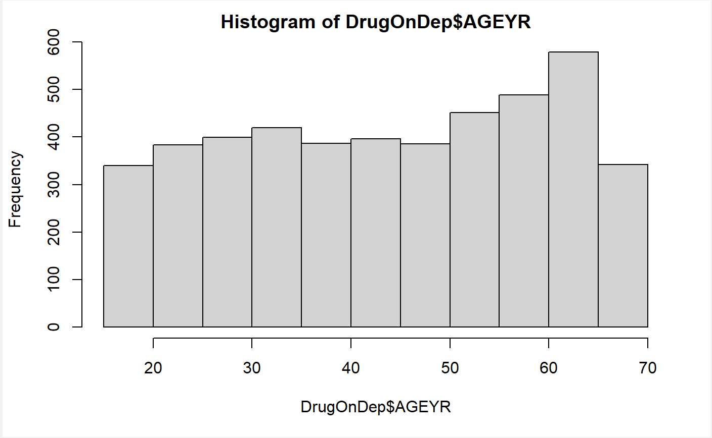
Appendix 1 - Visualizations

Slide 22
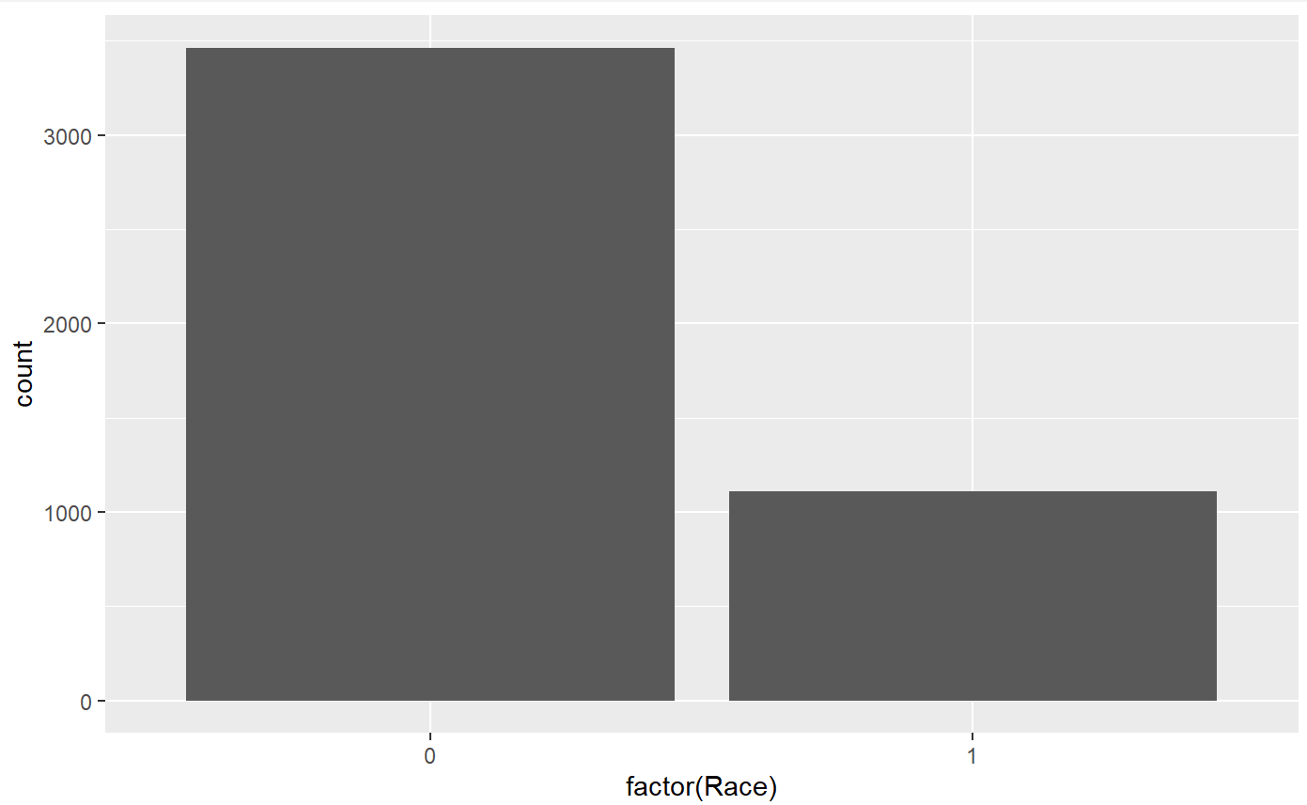
Appendix 2 - Visualizations

Slide 23
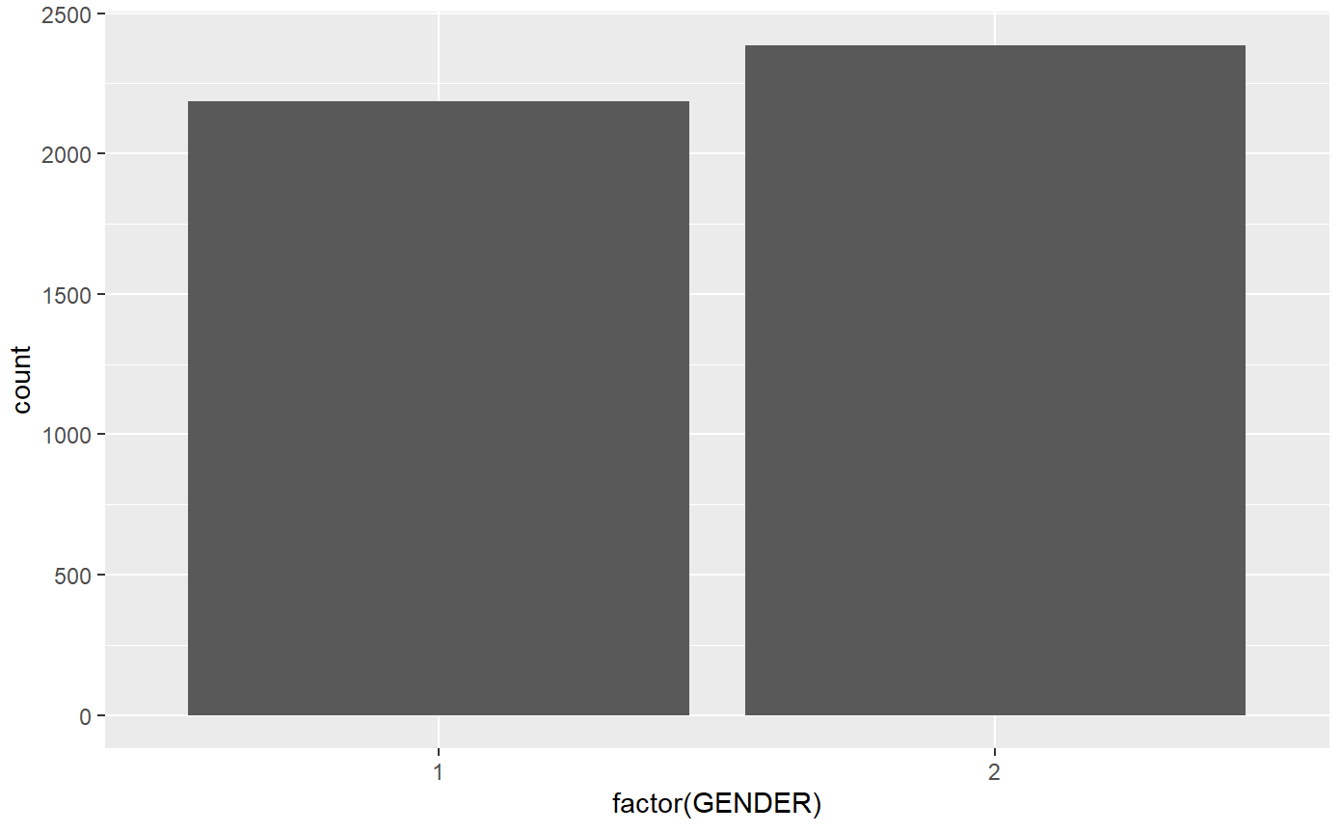
Appendix 3 - Visualizations

Slide 24

Appendix 4 - Visualizations

Slide 25
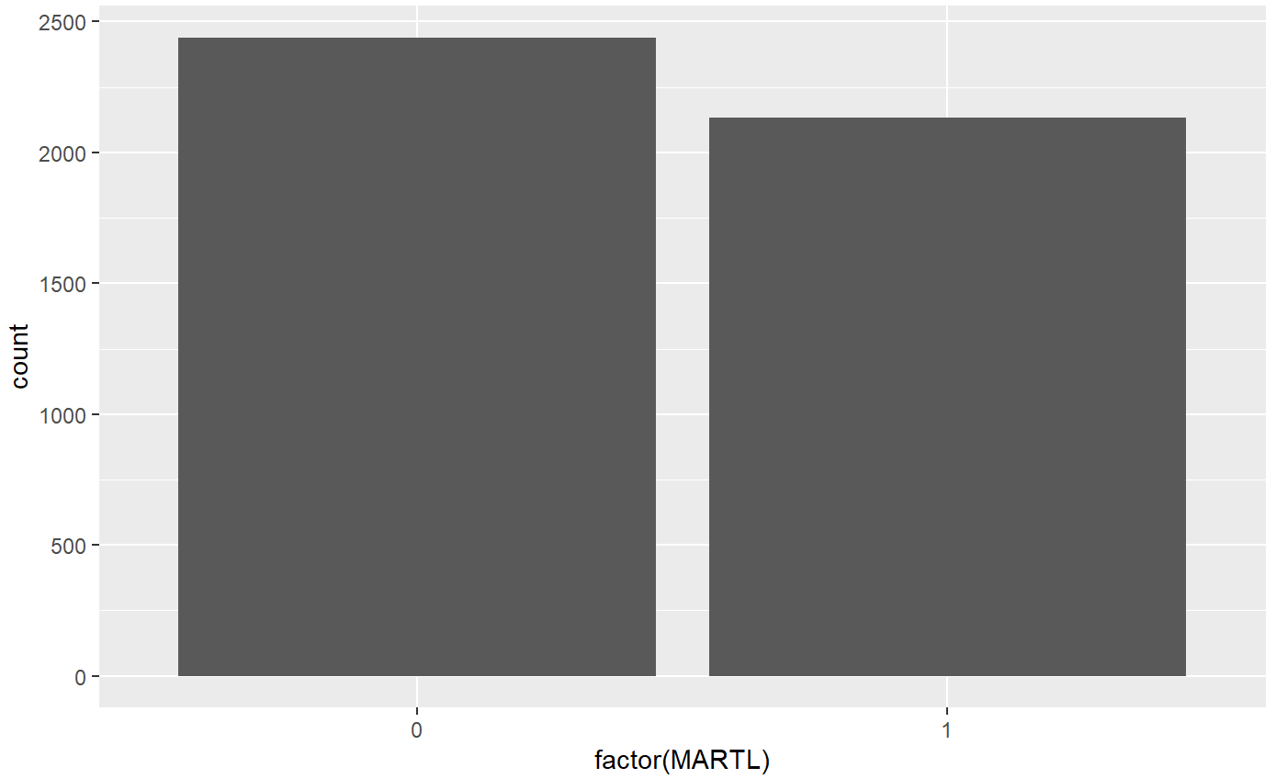
Appendix 5 - Visualizations

Slide 26
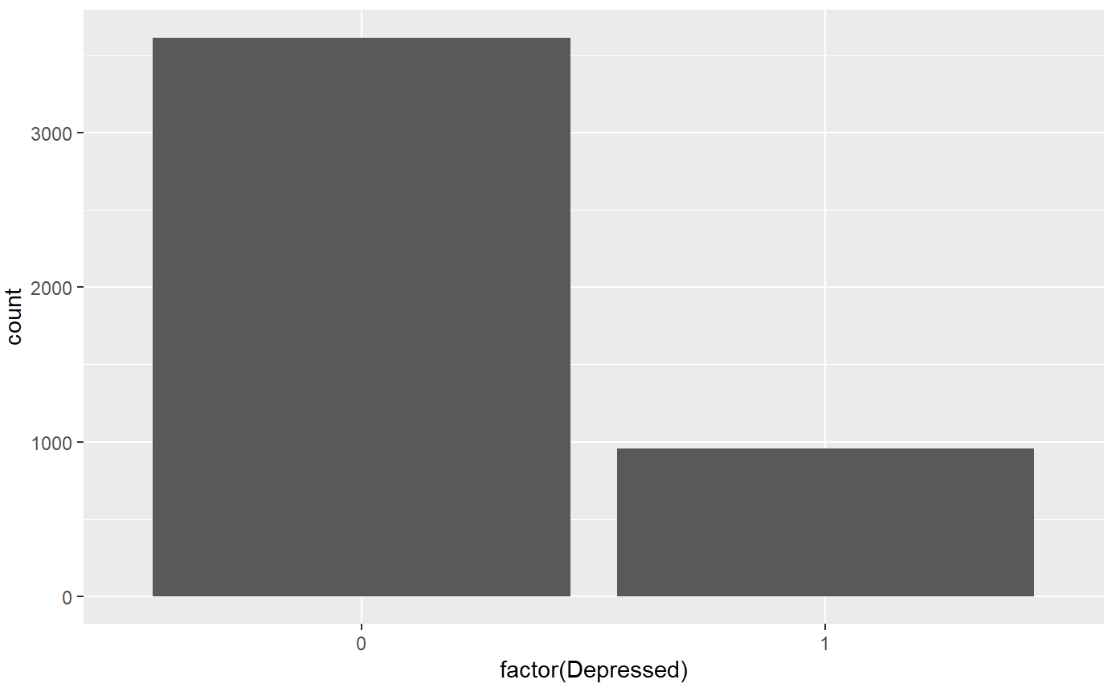
Appendix 6 - Visualizations

Slide 27
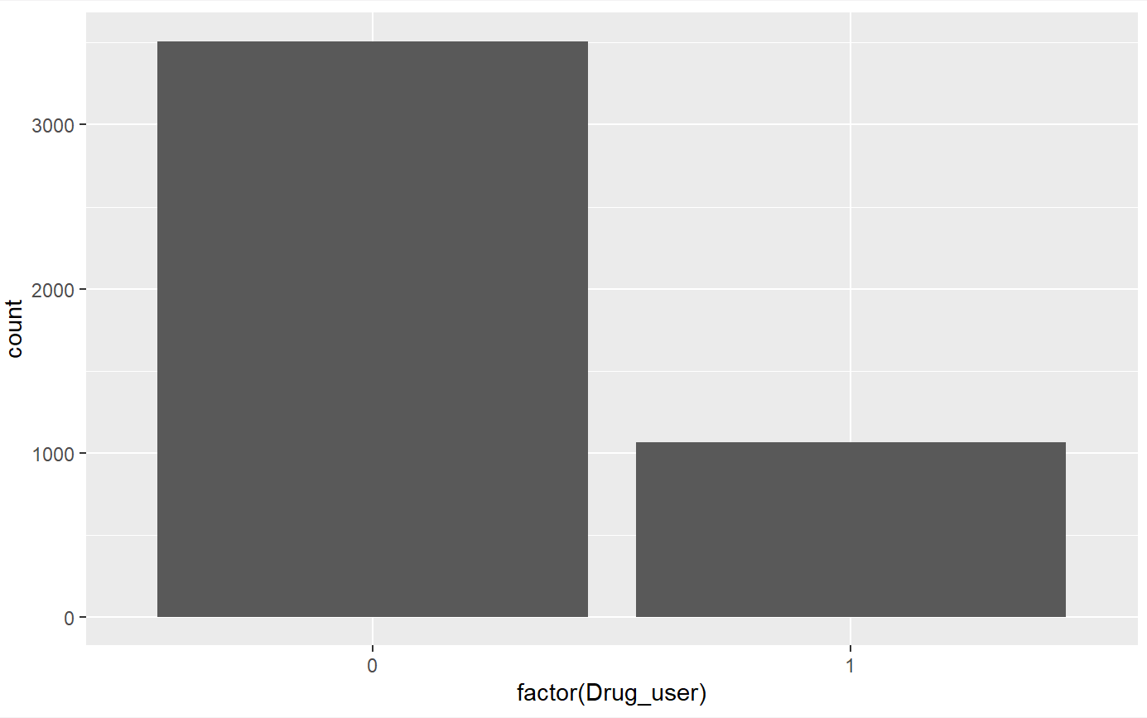
Appendix 7 - Visualizations

Slide 28
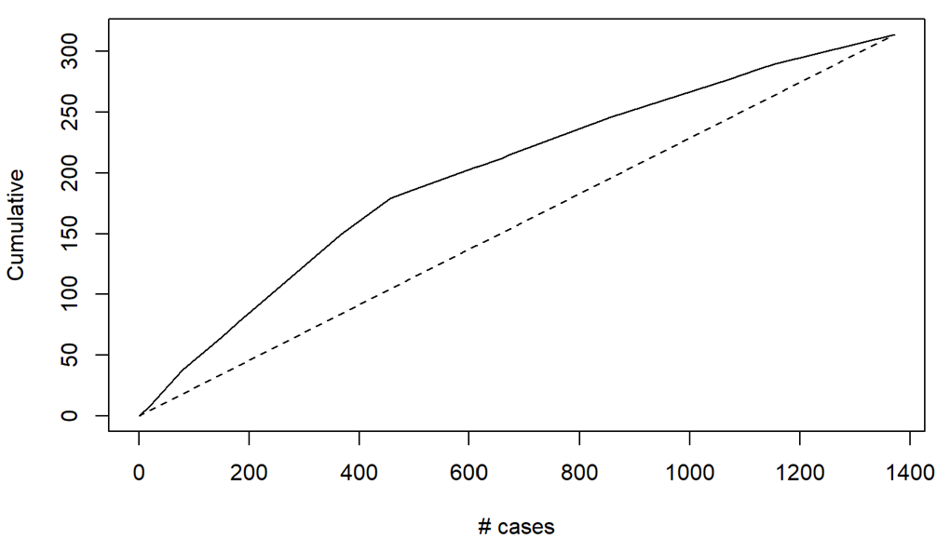
Appendix 8 - Visualizations

Slide 29
Appendix 9 – Variable Counts
Row Labels | # of Depressed/Non-Depressed
0 | 3616
1 | 956
Grand Total | 4572
Row Labels | Cocaine Users
0 | 3901
1 | 639
2 | 30
7 | 2
Grand Total | 4572
Row Labels | Count of Drug_user
0 | 3508
1 | 1064
Grand Total | 4572
Row Labels | Count of Race
1 | 687
2 | 458
3 | 1354
4 | 1109
5 | 964
Grand Total | 4572
Row Labels | Count of GENDER
1 | 2186
2 | 2386
Grand Total | 4572

Slide 30
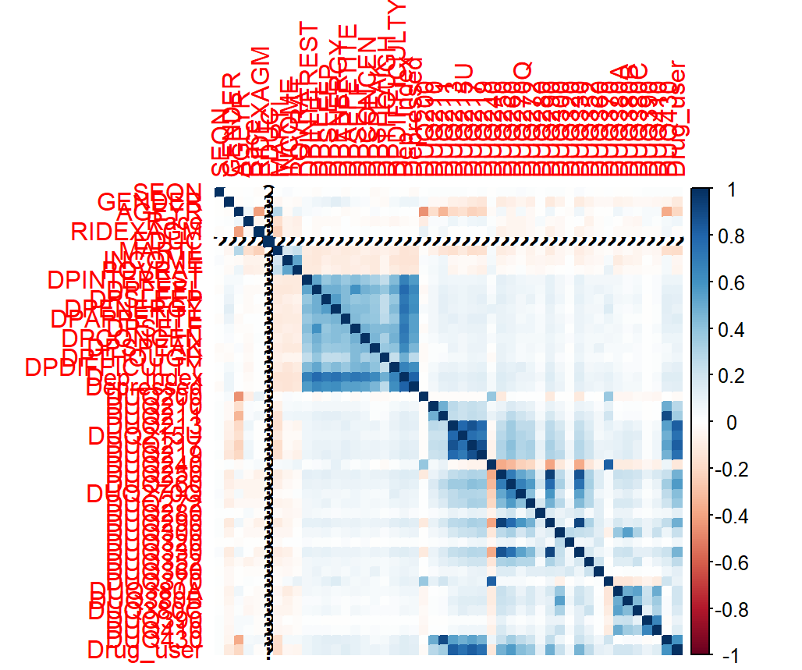
Appendix 10 - Visualizations

Slide 31
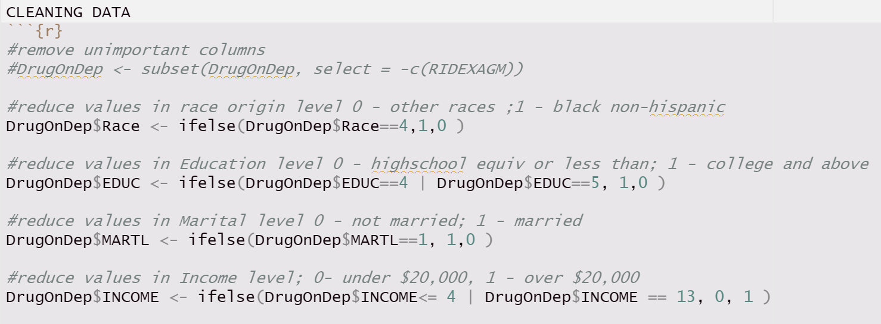
Appendix 11 – Creating Binary Variables

Slide 32
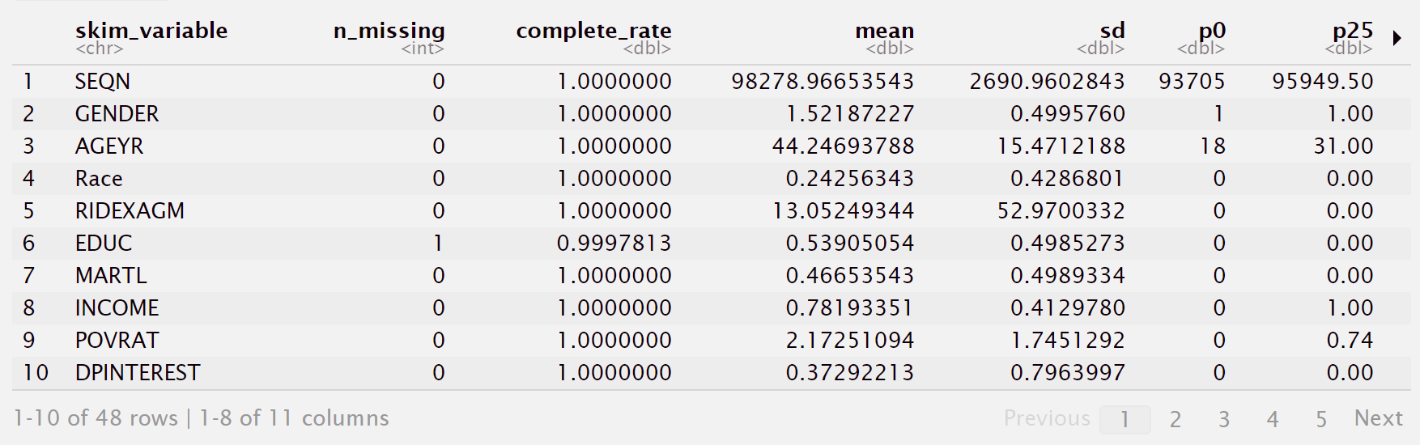
Appendix 12 – Data Structure

Slide 33
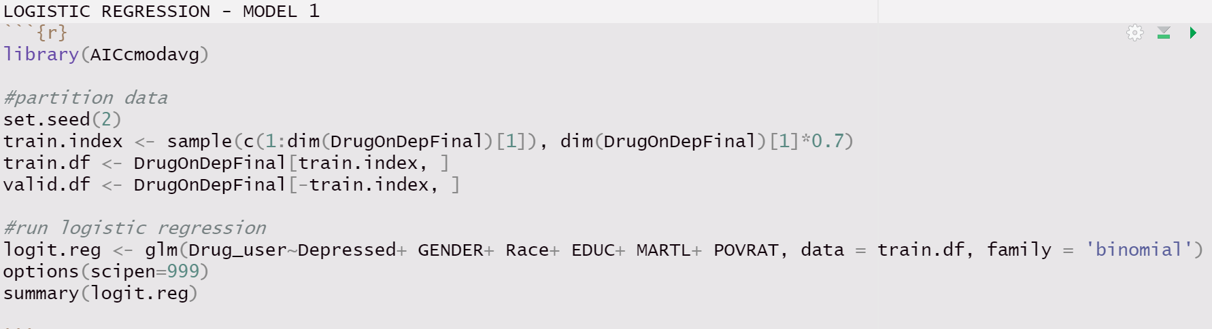
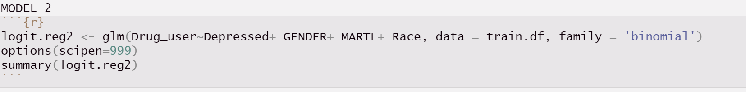
Appendix 13 – Logistic Regression

Slide 34
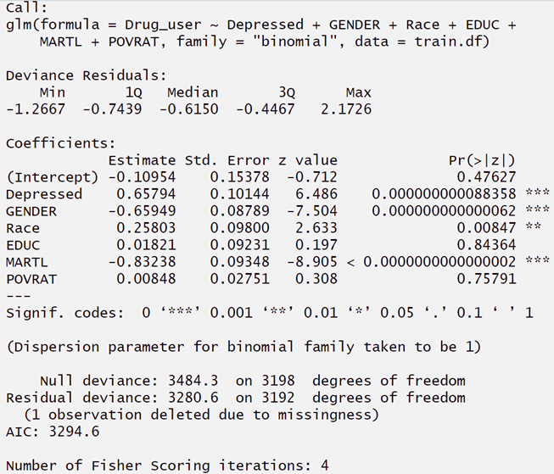
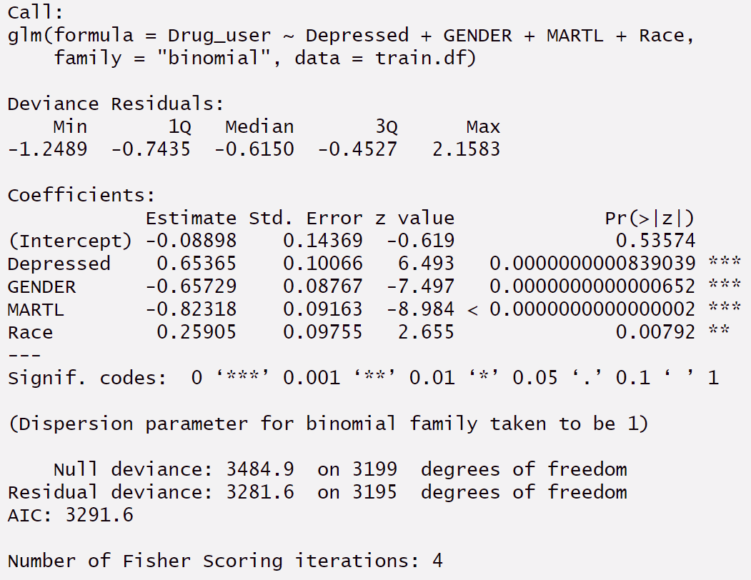
Appendix 14 – Logistic Regression

Slide 35
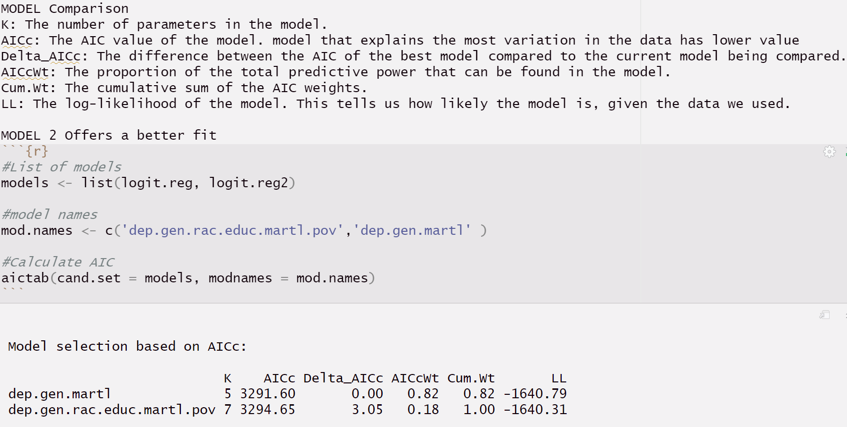
Appendix 15 – Model Comparison

Slide 36
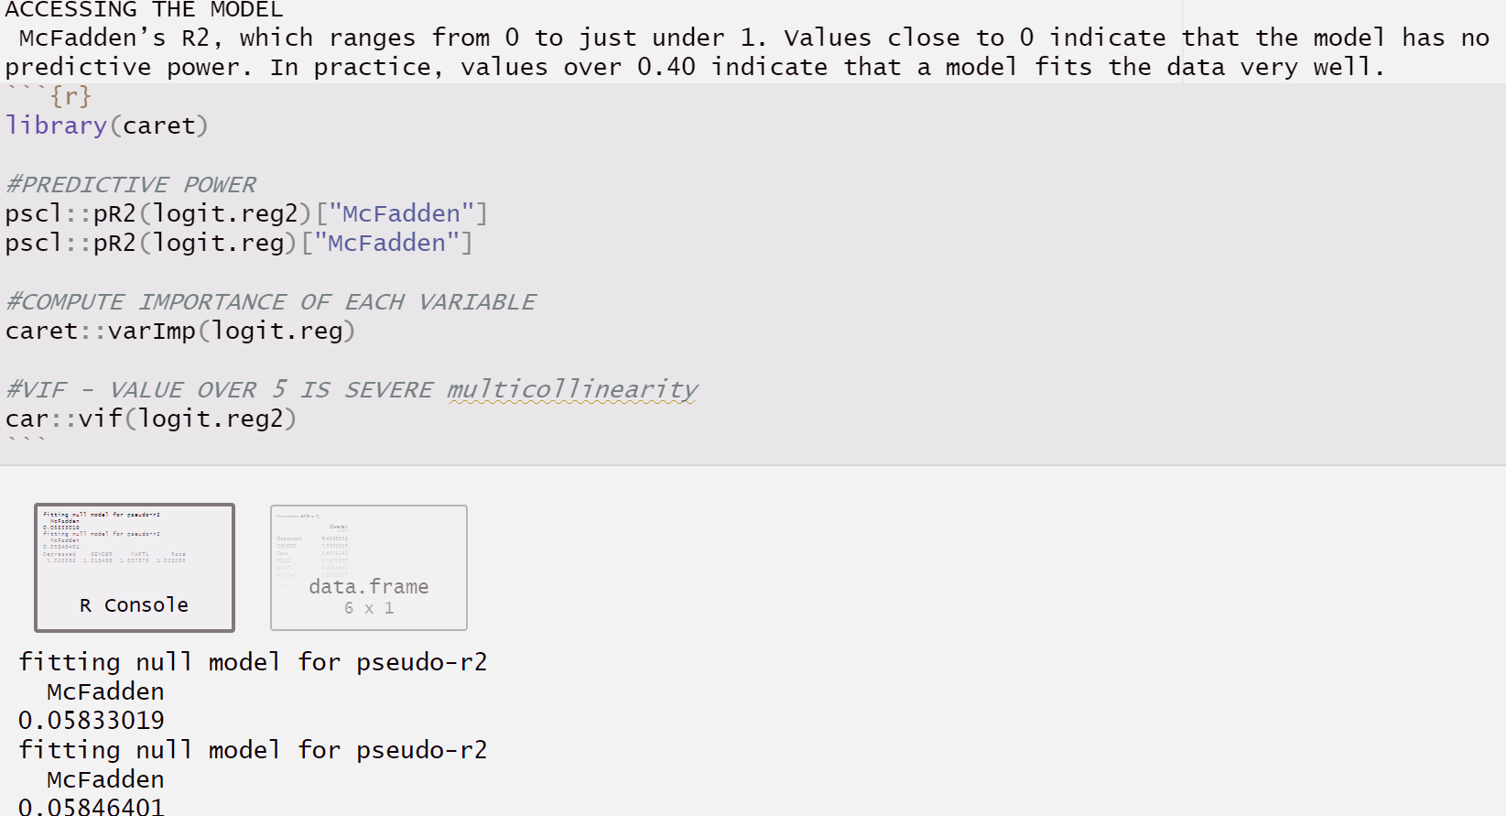
Appendix 16 – Accessing the model

Slide 37
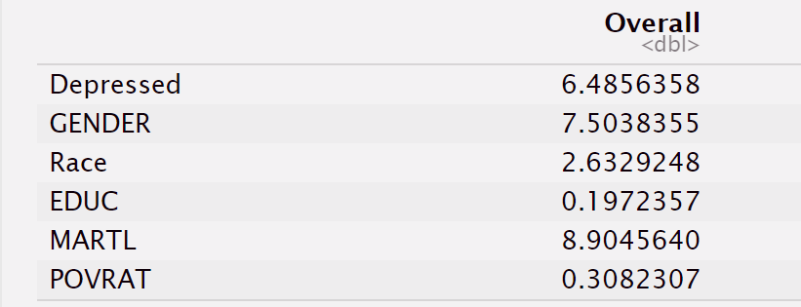
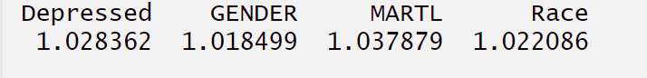
Appendix 17 - Accessing the model

Slide 38
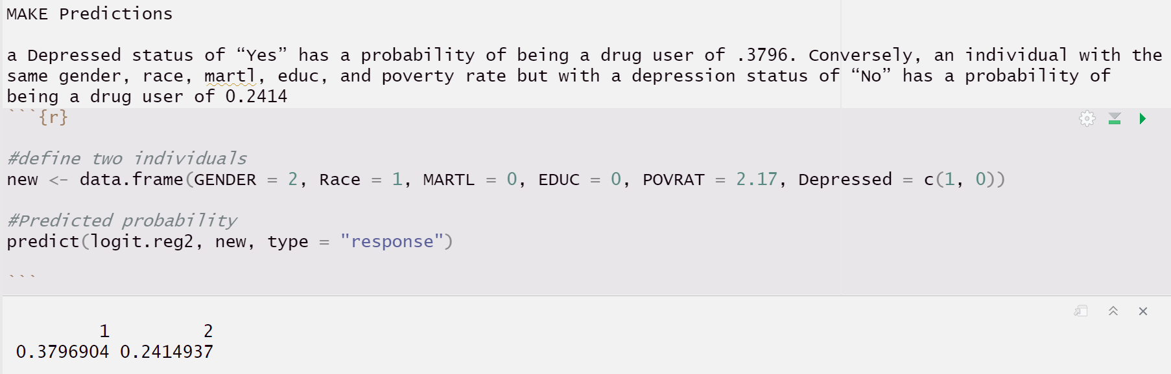
Appendix 18 - Predictions

Slide 39
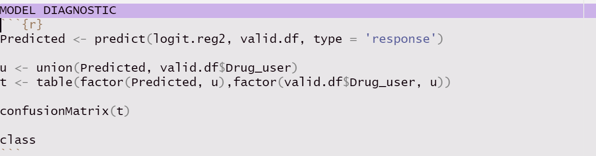
Appendix 19 - MODEL DIAGNOSTIC

Slide 40
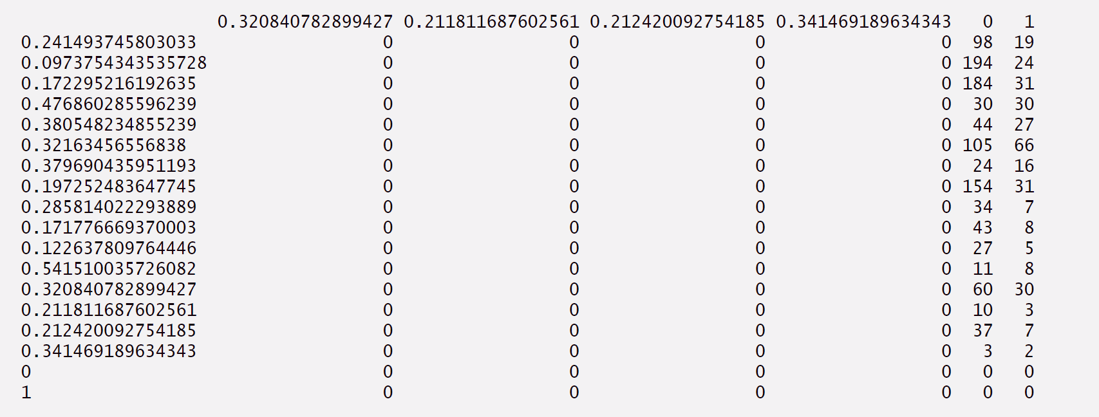
Appendix 20 - MODEL DIAGNOSTIC

Slide 41
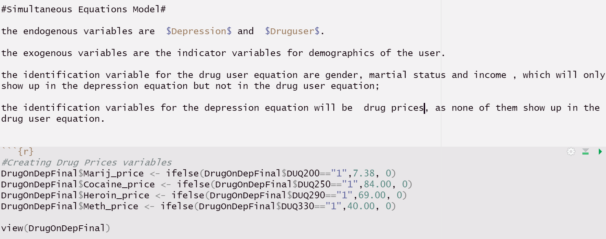
Appendix 21 - Simultaneous Equations Model

Slide 42
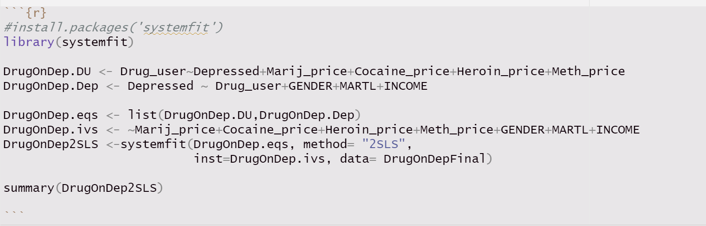
Appendix 22 - Simultaneous Equations Model (2SLS)

Slide 43
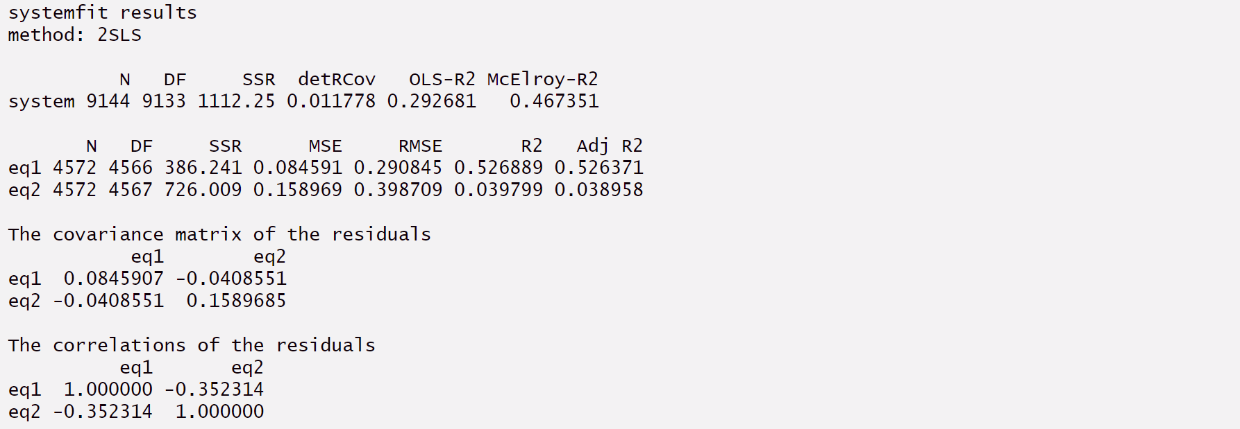
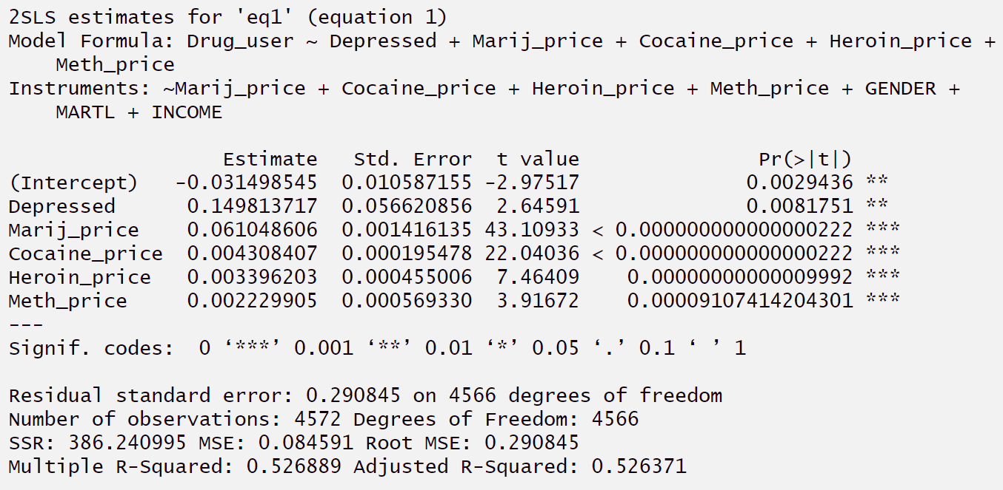
Appendix 23 - Simultaneous Equations Model (2SLS)

Slide 44
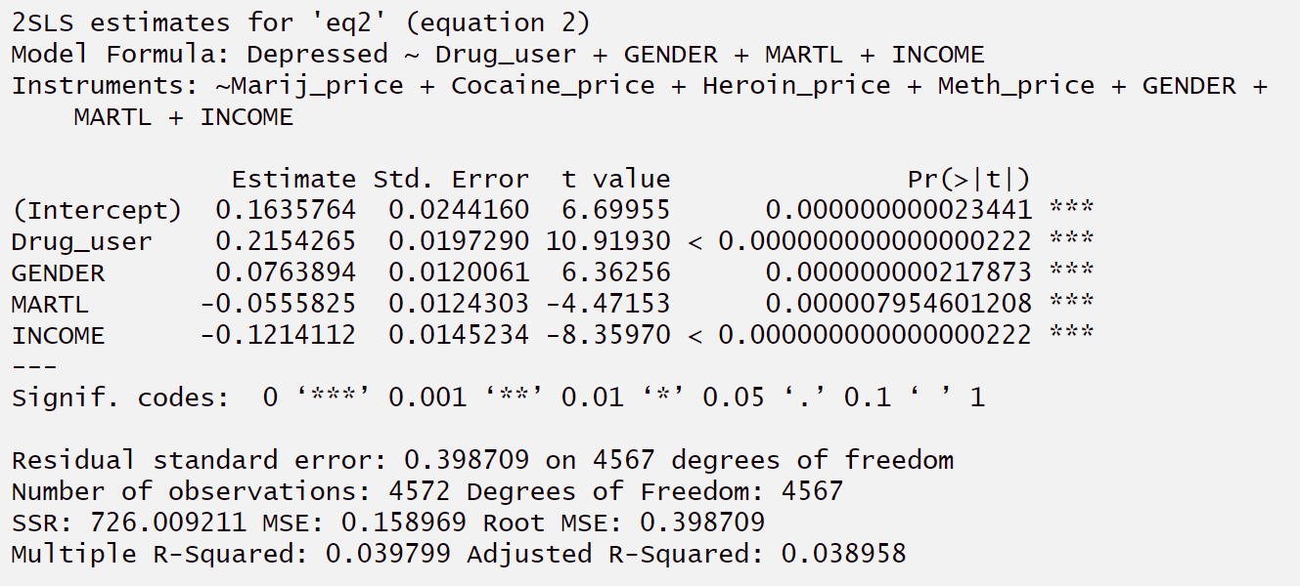
Appendix 24 - Simultaneous Equations Model (2SLS)

Slide 45
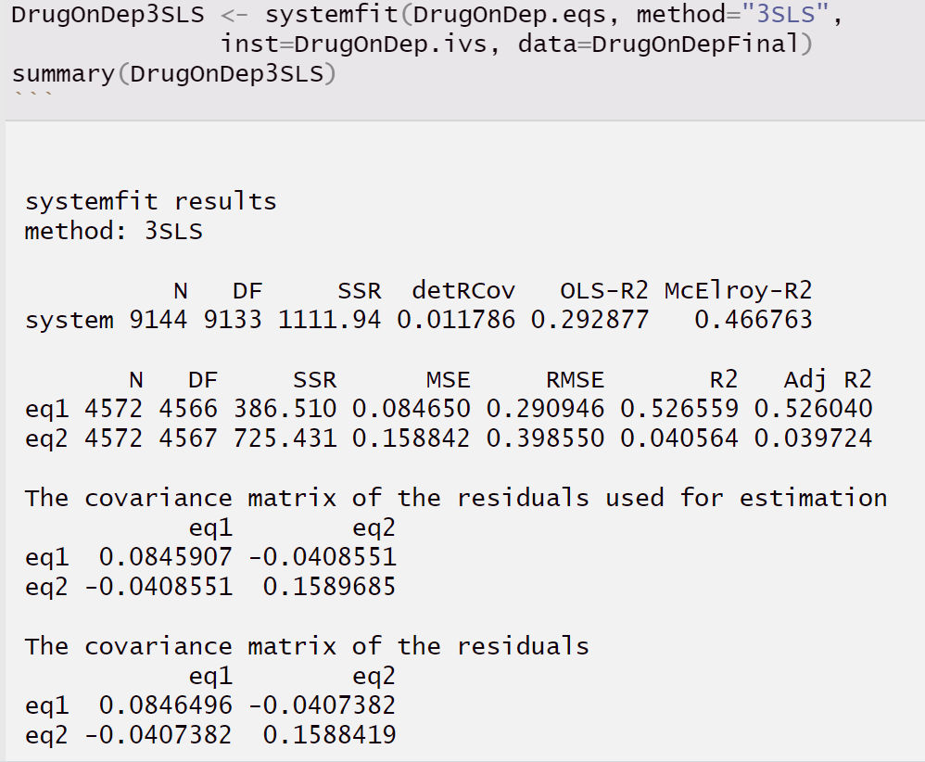
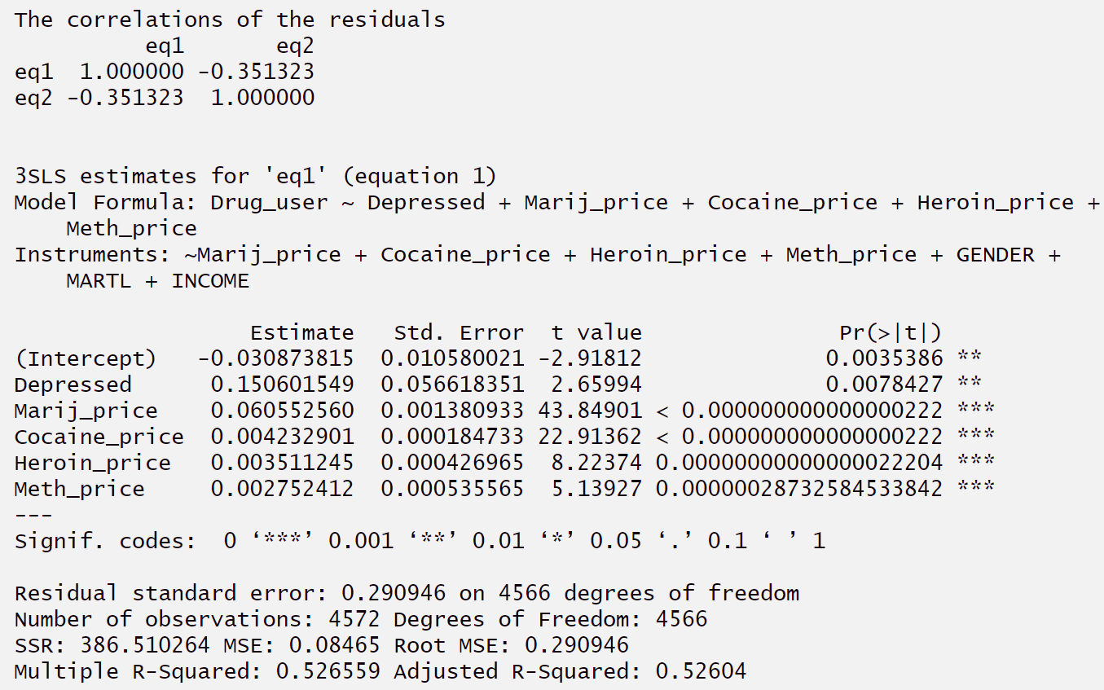
Appendix 25 - Simultaneous Equations Model (3SLS)

Slide 46
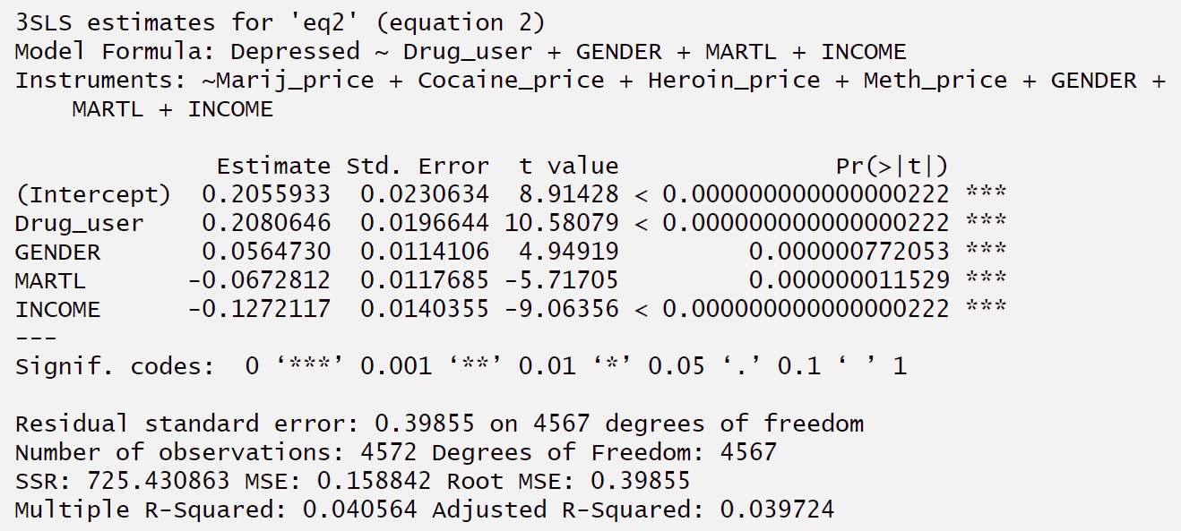
Appendix 26 - Simultaneous Equations Model (3SLS)

Slide 47
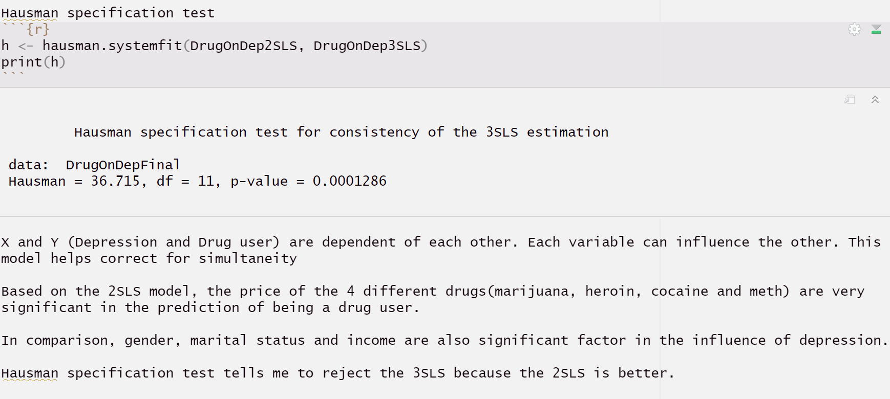
Appendix 27 - Hausman specification test

Slide 48
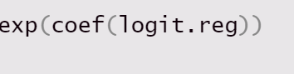
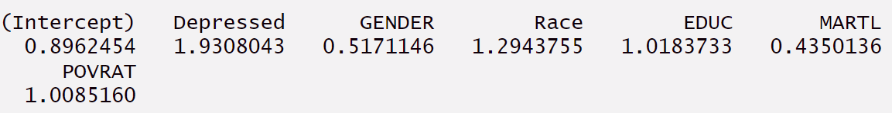
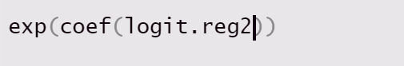
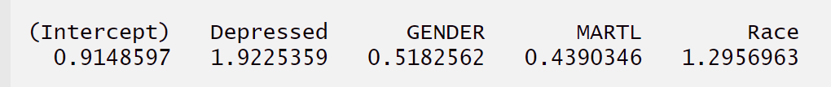
Appendix 28 – ODDS RATIO

Slide 49
References
Depression. (n.d.). National Institute of Mental Health (NIMH). https://www.nimh.nih.gov/health/topics/depression
Major Depression. (n.d.). National Institute of Mental Health (NIMH). https://www.nimh.nih.gov/health/statistics/major-depression
Villarroel, M., & Terlizzi, E. P. (2020). Symptoms of Depression Among Adults: United States, 2019. NCHS Data Brief, 379, 1–8. https://pubmed.ncbi.nlm.nih.gov/33054920/
Bustamante, J. (2023, January 1). Drug Abuse Statistics. NCDAS. https://drugabusestatistics.org/
NHANES - About the National Health and Nutrition Examination Survey. (n.d.). https://www.cdc.gov/nchs/nhanes/about_nhanes.htm
Income inequality and depression: a systematic review and meta-analysis of the association and a scoping review of mechanisms. (n.d.). https://onlinelibrary.wiley.com/doi/full/10.1002/wps.20492

